Slide 1
SSI CSI Local Survey Satisfaction Score April 2020
PT Nissan Motor Indonesia
Customer Quality

Slide 2
CSI & SSI NATIONAL

Slide 3
SSI CSI by Area – April 2020
NATIONAL
SSI | 947
CSI | 884
SSI Target : | 930
CSI Target : | 880
SUMATERA | RESULT | RANK
SSI | 945 | 6
CSI | 890 | 3
RMMG
SSI | 986
CSI | 948
KALIMANTAN | RESULT | RANK
SSI | 916 | 8
CSI | 880 | 4
JKMG
SSI | 919
CSI | 888
SULAWESI | RESULT | RANK
SSI | 955 | 3
CSI | 880 | 5
IMG
SSI | 949
CSI | 878
CENTRAL JAVA | RESULT | RANK
SSI | 963 | 1
CSI | 897 | 2
WSBYG
SSI | 884
CSI | 928
WEST JAVA | RESULT | RANK
SSI | 947 | 5
CSI | 907 | 1
BALI LOMBOK | RESULT | RANK
SSI | 955 | 2
CSI | 872 | 7
DPOG
SSI | 964
CSI | 844
JABODETABEK |  | RESULT | RANK
SSI |  | 944 | 7
CSI |  | 871 | 8
JABO 1 | SSI | 975
 | CSI | 876
JABO 2 | SSI | 925
 | CSI | 868
EAST JAVA | RESULT | RANK
SSI | 951 | 4
CSI | 876 | 6
MPAG
SSI | 960
CSI | 954
AKAG
SSI | 954
CSI | 886
 | SSI and CSI Index Region >= Target
 | SSI or CSI Index Region < Target
 | SSI and CSI Index Region < Target
MUAG
SSI | 0
CSI | 772

Slide 4
SSI CSI by Area – April 2020 – CSA (1/3)
NATIONAL
SSI | 947
CSI | 884
SSI Target : | 930
CSI Target : | 880
JABODETABEK
CSA #1 | RESULT | RANK
SSI | 918 | 28
CSI | 866 | 30
CSA #2 | RESULT | RANK
SSI | 0 | 36
CSI | 857 | 36
CSA #3 | RESULT | RANK
SSI | 935 | 24
CSI | 879 | 23
CSA #4 | RESULT | RANK
SSI | 0 | 37
CSI | 871 | 26
CSA #5 | RESULT | RANK
SSI | 962 | 16
CSI | 864 | 32
CSA #6 | RESULT | RANK
SSI | 822 | 34
CSI | 801 | 43
CSA #8 | RESULT | RANK
SSI | 0 | 38
CSI | 905 | 10
CSA #9 | RESULT | RANK
SSI | 964 | 14
CSI | 860 | 34
CSA #10 | RESULT | RANK
SSI | 884 | 30
CSI | 888 | 17
WEST JAVA
CSA #17 | RESULT | RANK
SSI | 0 | 39
CSI | 932 | 3
CSA #18 | RESULT | RANK
SSI | 1,000 | 1
CSI | 905 | 9
CSA #19 | RESULT | RANK
SSI | 940 | 21
CSI | 900 | 12
CSA #20 | RESULT | RANK
SSI | 939 | 22
CSI | 931 | 4
CSA #21 | RESULT | RANK
SSI | 0 | 40
CSI | 869 | 29
CSA #22 | RESULT | RANK
SSI | 1,000 | 2
CSI | 886 | 19
CSA #11 | RESULT | RANK
SSI | 919 | 27
CSI | 888 | 18
CSA #12 | RESULT | RANK
SSI | 967 | 12
CSI | 944 | 2
CSA #13 | RESULT | RANK
SSI | 954 | 19
CSI | 886 | 20
CSA #15 | RESULT | RANK
SSI | 973 | 11
CSI | 842 | 40
CSA #16 | RESULT | RANK
SSI | 964 | 13
CSI | 844 | 38
 | SSI and CSI Index Region >= Target
 | SSI or CSI Index Region < Target
 | SSI and CSI Index Region < Target

Slide 5
SSI CSI by Area – April 2020 – CSA (2/3)
NATIONAL
SSI | 947
CSI | 884
SSI Target : | 930
CSI Target : | 880
SUMATERA
CSA #41 | RESULT | RANK
SSI | 995 | 7
CSI | 910 | 8
CSA #42 | RESULT | RANK
SSI | 1,000 | 4
CSI | 897 | 14
CSA #43 | RESULT | RANK
SSI | 815 | 35
CSI | 858 | 35
CSA #44 | RESULT | RANK
SSI | 986 | 8
CSI | 948 | 1
CSA #45 | RESULT | RANK
SSI | 979 | 10
CSI | 893 | 15
CSA #46 | RESULT | RANK
SSI | 951 | 20
CSI | 870 | 28
CSA #47 | RESULT | RANK
SSI | 864 | 33
CSI | 898 | 13
SULAWESI
CSA #39 | RESULT | RANK
SSI | 986 | 9
CSI | 873 | 24
CSA #40 | RESULT | RANK
SSI | 924 | 25
CSI | 886 | 21
EAST JAVA
CSA #31 | RESULT | RANK
SSI | 963 | 15
CSI | 843 | 39
CSA #32 | RESULT | RANK
SSI | 917 | 29
CSI | 853 | 37
CENTRAL JAVA
CSA #23 | RESULT | RANK
SSI | 936 | 23
CSI | 862 | 33
CSA #25 | RESULT | RANK
SSI | 997 | 5
CSI | 903 | 11
CSA #26 | RESULT | RANK
SSI | 1,000 | 3
CSI | 826 | 42
 | SSI and CSI Index Region >= Target
 | SSI or CSI Index Region < Target
 | SSI and CSI Index Region < Target

Slide 6
SSI CSI by Area – April 2020 – CSA (3/3)
NATIONAL
SSI | 947
CSI | 884
SSI Target : | 930
CSI Target : | 880
KALIMANTAN
CSA #36 | RESULT | RANK
SSI | 873 | 32
CSI | 865 | 31
CSA #37 | RESULT | RANK
SSI | 0 | 43
CSI | 841 | 41
CSA #38 | RESULT | RANK
SSI | 959 | 17
CSI | 891 | 16
UIS SURABAYA
CSA #27 | RESULT | RANK
SSI | 921 | 26
CSI | 881 | 22
CSA #29 | RESULT | RANK
SSI | 995 | 6
CSI | 912 | 7
CSA #30 | RESULT | RANK
SSI | 0 | 41
CSI | 917 | 6
BALI LOMBOK
CSA #33 | RESULT | RANK
SSI | 0 | 42
CSI | 871 | 27
CSA #34 | RESULT | RANK
SSI | 955 | 18
CSI | 873 | 25
SB YOGYAKARTA
CSA #24 | RESULT | RANK
SSI | 884 | 31
CSI | 928 | 5
 | SSI and CSI Index Region >= Target
 | SSI or CSI Index Region < Target
 | SSI and CSI Index Region < Target

Slide 7
Executive Summary – SSI CSI National (April 2020)
1. SSI NISSAN INDEX
2. CSI TOTAL INDEX
Overall the results of Nissan's SSI satisfaction in April 2020 are good, compared to the SSI target of 930 and in April 2020 is 947
The factors that make a good score of SSI:
Having the same trend with SSI Nissan, overall satisfaction of CSI is above the target score (+4pts; 880 to 884)
The factors that make a good score of CSI:
Factors | Touch Points
Dealership Personnel | Serves efficiently and quickly (9.74)
Delivery Process | Ability to deliver vehicle at promised date/ time (9.71)
Sales Initiation | Thoroughness of Salesperson to follow up on your enquiries/requests (9.54)
Deal | Ease of coming to agreement on a final deal (9.64)
Dealership Facility | Ease of looking at models on display (9.62)
Paperwork | Transparency of paperwork/finance process (9.58)
Factors | Touch Points
Service Quality (+0.05pts) | Satisfaction with the quality of work performed on your vehicle (8.84)
Vehicle Pickup (+0.05pts) | Satisfaction with vehicle pick-up process from Dealer (8.98)
Service Initiation (+0.03pts) | Flexibility to accommodate schedule (8.88)
Service Advisor (+0.03pts) | Courtesy of Service Advisor (9.17)
Service Facility (+0.03pts) | Cleanliness of dealership (8.89)
3. COMPLIANCE HIGHLIGHT
SSI NISSAN
Low compliance still happened on:
Nissan users are not quite satisfied with the service provided because they are not contacted by sales after the vehicle is delivered
CSI TOTAL
Need to take action on “Vehicle washed and vacuumed after service” and “Service Advisor tell the reason of delay in service time”

Slide 8
OVERALL INDEX NATIONAL

Slide 9
CSI & SSI Trend – National Nissan (April 2020)
Positive score seems on sales performance Nissan and aftersales performance. Its score are going up by 17pts and 4pts. From the target.
Looking into bottom box performance there still 1.7% of the customer dissatisfied on this period.
SSI Index Score Result
CSI Index Score Result
Sample Size
98
Sample Size
1,315
SSI Bottom Box Result
CSI Bottom Box Result
Sample Size
2*
Sample Size
23*
*read with cautions for small base

Slide 10
Hot Alert – CSI Nissan Datsun National (1/2)
Group |  | Freq (n=23) | Freq (%)
Service Initiation | SI | 3 | 13%
Service Advisor | SA | 6 | 26%
Service Facility | SF | 3 | 13%
Vehicle Pick up | VP | - | -
Service Quality | SQ | 11 | 48%
No | Dealer Code | Dealer Name | Score CSI | OS Score | Group | Verbatim
1 | C1013 | DATSUN ADAM MALIK | 730 | 4 | SQ | Agar lebih detail untuk mengerjakan keluhan.
2 | A6001 | NISSAN ALAM SUTERA | 772 | 5 | SA;SQ | Untuk service advisor jangan terlalu dominan agar lebih mendengar keluhan pelangan, agar memberikan solusi yang tepat dan servicenya tuntas.
3 | C1001 | NISSAN ARENGKA | 531 | 4 | SF;SQ | Fasilitas untuk ruang tunggu sebaiknya diperbaharui dari sofa dan TV, atau ada fasilitas tambahan seperti kursi pijat. Permintaan saya ke service advisor tidak sepenuhnya dilakukan.
4 | B1002 | NISSAN BASUKI RAHMAT | 804 | 4 | SQ | Untuk biaya service tidak sesuai dari pengecekan diawal service, bisa 2x lipat dari harga awal perjanjian.
5 | A1022 | NISSAN CIKARANG | 678 | 4 | SQ | Agar jangan coba-coba, kalau memang cacatnya yang rusak diperbaiki, tapi kalau masih kemungkinan jangan langsung menilai, bahkan diberi harga Rp. 40 juta, (harus dipastikan dulu)
6 | A1043 | NISSAN GADING SERPONG | 631 | 3 | SA | Koordinasi antara service advicer dan mekanik diharapkan 50-50 antara mekanik yang senior dan yang junior.
7 | A1043 | NISSAN GADING SERPONG | 615 | 5 | SQ | Agar service lebih cepat.
8 | B1011 | NISSAN GATOT SUBROTO BALI | 566 | 5 | SA | Pelayanan service advisor harus bekerja lebih cepat. Harga mahal.
9 | C1004 | NISSAN ISTANA | 733 | 4 | SQ | Mekaniknya klo masih rusak bilang tidak bisa jangan bilang sudah OK.
10 | B1009 | NISSAN KEDAWUNG | 700 | 4 | SA | Agar service advisornya lebih memahami macam-macam kerusakan yang dikeluhkan oleh pelanggan.

Slide 11
Hot Alert – CSI Nissan Datsun National (2/2)
Group |  | Freq (n=23) | Freq (%)
Service Initiation | SI | 3 | 13%
Service Advisor | SA | 6 | 26%
Service Facility | SF | 3 | 13%
Vehicle Pick up | VP | - | -
Service Quality | SQ | 11 | 48%
No | Dealer Code | Dealer Name | Score CSI | OS Score | Group | Verbatim
11 | F1001 | NISSAN KUPANG | 753 | 5 | SQ | Kalau bisa alat scan mendeteksi sampai ke dalam mesin, jangan cuma kelistrikan saja, jadi untuk perbaikan lebih detail bukan berdasarkan analisis saja. Kalau bisa harga service dan spare part tidak terlalu mahal.
12 | B1030 | NISSAN PEKALONGAN | 601 | 4 | SQ | Agar setiap keluhan pemilik kendaraan kalau sudah diberi rekomendasi kepercayaan ya bebas saja diperiksa dan dikerjakan saja. Diperbaiki sesuai kerusakan.
13 | B1003 | NISSAN PURI ANJASMORO | 728 | 5 | SI;SA | Pendaftaran awal pada saat mau service, pelayanannya kurang ramah (terlihat cenderung customer yang sangat membutuhkan). Untuk biaya service dan penggantian part untuk biaya jangan terlalu sendiri2.
14 | B1013 | NISSAN PURWOKERTO | 728 | 5 | SF;SQ | Agar bisa menambah mekanik saat service, Tempat untuk service paling tidak bisa menampung 5 kendaraan sekaligus pada saat service.
15 | B1021 | NISSAN SANDUBAYA | 506 | 4 | SI;SA;SQ | Kinerja SDM kurang profesional, biaya service yang diminta terlalu mahal serta penggantian spare part juga mahal. Saya mendapat gratis penggantian oli setelah sampai di bengkel ternyata olinya tidak bagus.
16 | A3002 | NISSAN TOMANG | 588 | 2 | SF | Ruang tunggu kebersihan ditingkatkan, tisu habis tidak diisi, AC kurang dingin, agak kotor dan banyak sampah.
17 | A1010 | NISSAN WARUNG BUNCIT | 687 | 3 | SI | Seharusnya detail bertanya tentang pekerjaan apa yang dibutuhkan pelanggan. contohnya pelanggan datang dengan keluhan pemasangan spare part saja, jadi dicharge spare part saja. Bukan dicharge harga service full.

Slide 12
Hot Alert – SSI Nissan National
Group |  | Freq (n=23) | Freq (%)
Fasilitas Dealer | DF | - | -
Salesperson | SP | 1 | 100%
Negosiasi/Deal | Deal | - | -
Proses Administrasi | Adm | - | -
Waktu Pengiriman Kendaraan | DT | - | -
Penyerahan Kendaraan | DP | - | -
No | Dealer Code | Dealer Name | Index Score | OS Score | Group | Verbatim
1 | A1043 | NISSAN GADING SERPONG | 660 | 5 | SP | Salesnya masih baru, product knowledgenya mengenai kendaraan masih jauh tapi sudah terjun ke lapangan. Setelah after sales pembelian kurang up-date, Saya yg terus menanyakan.

Slide 13
FACTOR COMPARISON NATIONAL

Slide 14











Factor Comparison – SSI & CSI Nissan (National)
For the April period, the delivery process has the highest satisfaction score with 9.63 on SSI
And service advisor has the highest satisfaction score with 8.95 on CSI.
SSI Factor
SSI Score
Sales Initiation
Dealership Facility
Deal
Paperwork
Dealership Personnel
Delivery Process
CSI Factor
CSI Score
Service Initiation
Service Advisor
Service Facility
Vehicle Pickup
Service Quality
Apr’20
May’20
Jun’20

Slide 15
FACTOR ATTRIBUTES COMPARISON NATIONAL

Slide 16


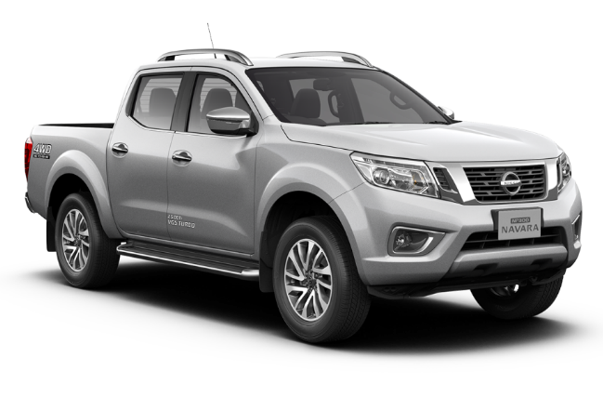
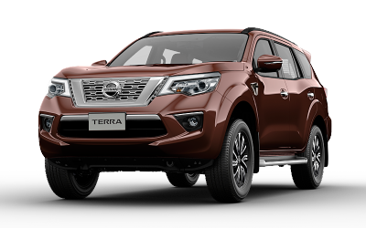
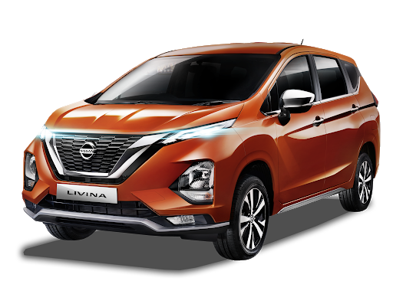
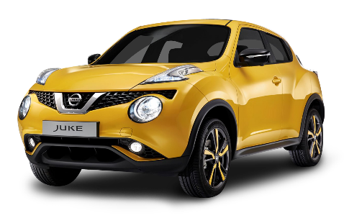
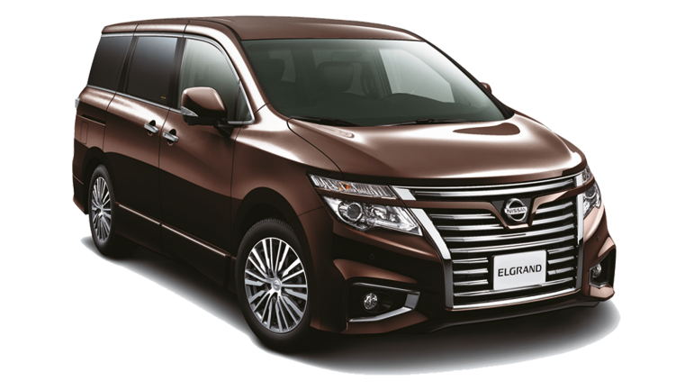
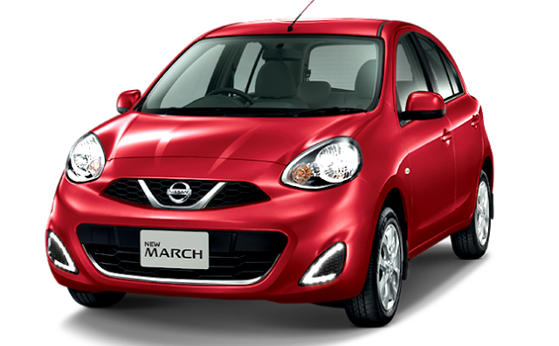
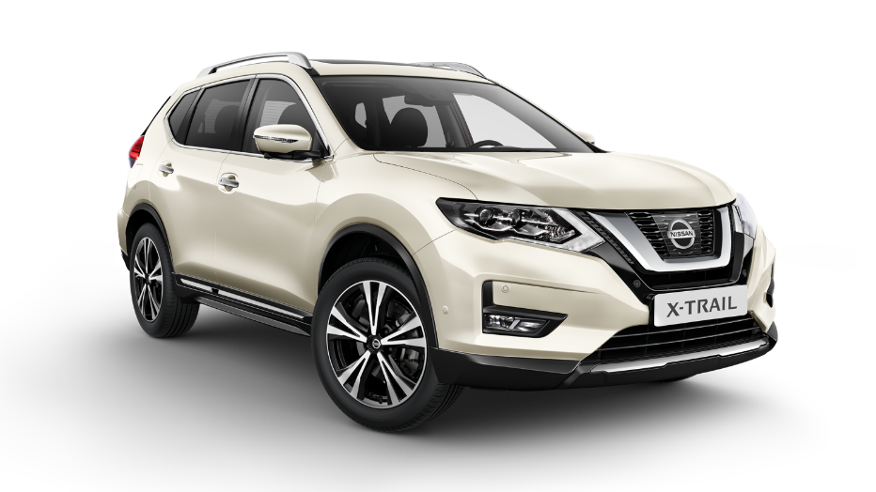
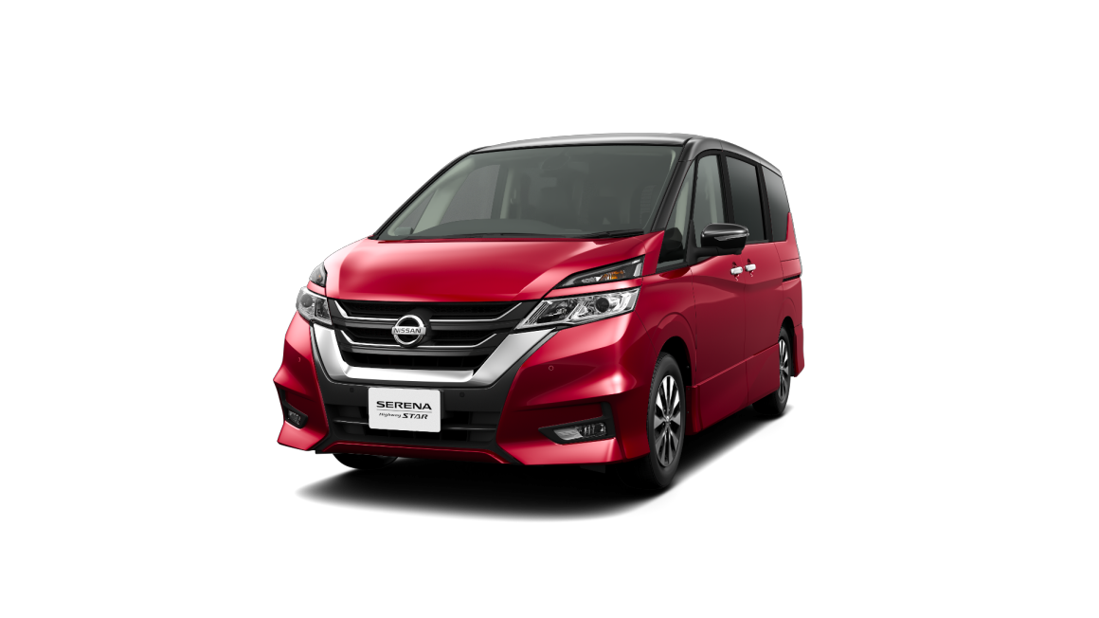
SSI Results

Slide 17


SSI Nissan Score & Compliance Trend – National (1/5)
According to Nissan car buyers, Nissan sales are considered passive because most of them did not offer test drives.
But Nissan car buyers feel young when looking at models on display.
Mean Score
GAP
Base
Apr’20
Sales Initiation | Overall Satisfaction on Sales Initiation provided by salesperson |  | -
 | Salesperson's explanation of features, advantages, and benefits of vehicle |  | -
 | Overall satisfaction of test drive |  | -
 | Thoroughness of Salesperson to follow up on your enquiries/requests |  | -
Dealership Facility | Overall Satisfaction on Dealer Facility |  | -
 | Comfort in showroom |  | -
 | Ease of looking at models on display |  | -
 | Accessibility of the dealership |  | -
 | Quality of amenities |  | -
98
98
80
98
79
79
79
79
78
Apr ‘20 (n=98)
*read with cautions for small base

Slide 18


SSI Nissan Score & Compliance Trend – National (2/5)
“Ease of coming to agreement on a final deal“ and “Transparency of paperwork/finance process“ are the 2 things that are felt to be most convenient for buyers when they want to make a deal and take care of the paperwork of the vehicle
Mean Score
GAP
Base
Apr’20
Deal | Overall rating of the deal |  | -
 | Fairness of vehicle's price paid |  | -
 | Ease of coming to agreement on a final deal |  | -
 | Comfort of location negotiation |  | -
Paperwork | Overall paperwork process |  | -
 | Clarity of explaining documents |  | -
 | Transparency of paperwork/finance process |  | -
 | Timeliness of completing the final paperwork process |  | -
98
98
98
98
98
98
98
98
Apr ‘20 (n=98)
*read with cautions for small base

Slide 19

SSI Nissan Score & Compliance Trend – National (3/5)
Nissan sales in the eyes of its users have served them efficiently and quickly
Mean Score
GAP
Base
Apr’20
Dealership Personel | Overall Dealership Personnel |  | -
 | Knowledge about vehicles |  | -
 | Serves efficiently and quickly |  | -
 | Concern that you purchase the best vehicle for your needs |  | -
 | Courtesy and friendliness |  | -
 | Transparency of vehicles' price |  | -
 | Use of technology throughout the sales process |  | -
 | Effectiveness of non-face-to-face communication |  | -
98
98
98
98
98
97
98
98
Apr ‘20 (n=98)
*read with cautions for small base

Slide 20

SSI Nissan Score & Compliance Trend – National (4/5)
The plus point of Nissan's delivery process is the time delivery of the vehicle.
Mean Score
GAP
Base
Apr’20
Delivery Process | Overall rating of the delivery process |  | -
 | Condition of your vehicle |  | -
 | Effectiveness in explaining your vehicle’s features |  | -
 | Timeliness of completing the final delivery |  | -
 | Overall rating of the delivery timing |  | -
 | Length of time needed to deliver your vehicle |  | -
 | Appropriateness of updates regarding your vehicle delivery status |  | -
 | Ability to deliver vehicle at promised date/ time |  | -
97
98
98
98
98
97
98
98
Apr ‘20 (n=98)
*read with cautions for small base

Slide 21

SSI Nissan Score & Compliance Trend – National (5/5)
Nissan users are not quite satisfied with the service provided because they are not contacted by sales after the vehicle is delivered
Mean Score
GAP
Base
Apr’20
Follow Up | Overall rating of the delivery process |  | -
98
Compliance | Delivery Process | Interior and exterior clean and undamaged at delivery
 |  | Sales person explained the reason of lateness in delivery process
 |  | Salesperson delivered the vehicle
 |  | Delivered with special ceremony : Photo session
 |  | Thanked for purchase at delivery
 |  | Introduced to service personnel in service department
 |  | Contacted after delivery
98
1*
98
98
98
98
98
Apr ‘20 (n=98)
*read with cautions for small base

Slide 22

Follow-up after Vehicle Delivery – SSI Nissan
How long have you been
followed-up after the delivery?
n = 88

Slide 23
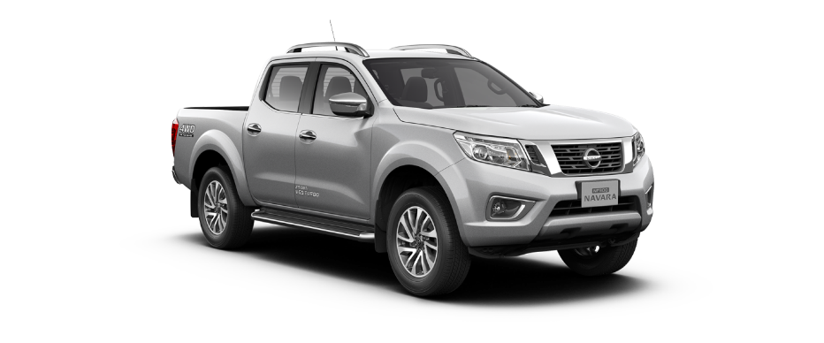
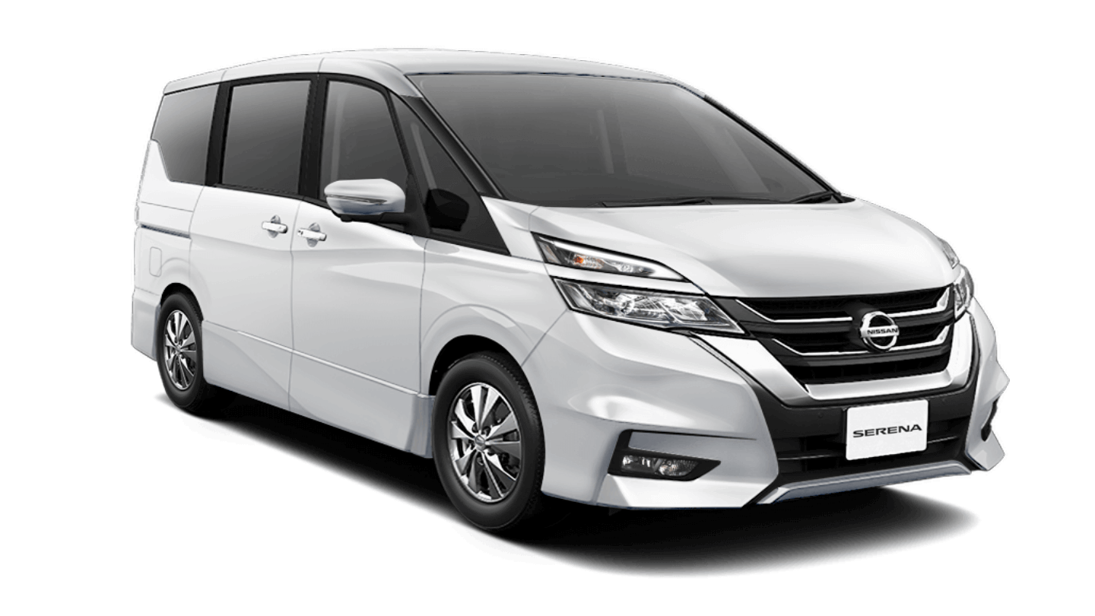
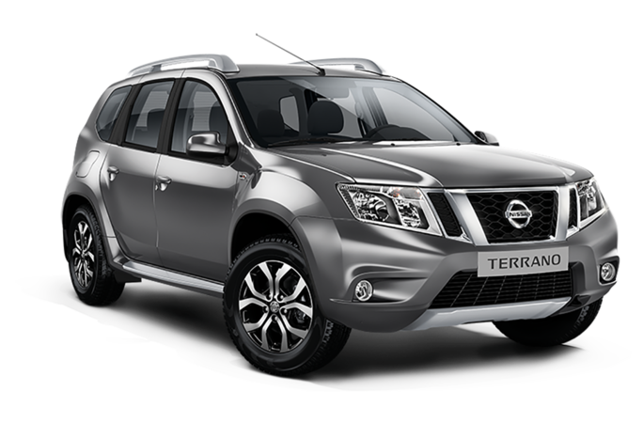
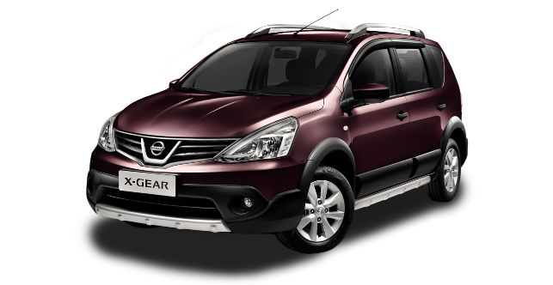

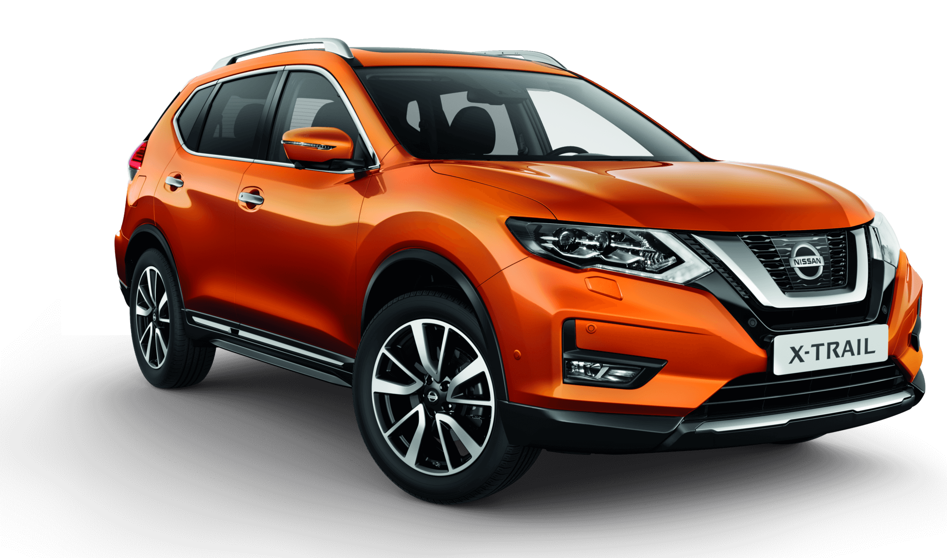

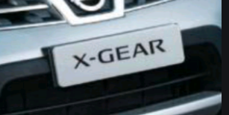

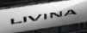
CSI Results

Slide 24

CSI Nissan Datsun Score & Compliance Trend – National (1/4)
Timeliness of the handover process is still considered to be one thing that needs to be improved by Nissan.
Mean Score
GAP
Base
Apr’20
Service Initiation | Satisfaction with service initiation provided by Sales Advisor |  | -
 | Ease of arranging service visit |  | -
 | Flexibility to accommodate schedule |  | -
 | Timeliness of hand over process |  | -
 | Convenient business days/ hours of operation |  | -
1,309
924
911
1,311
1,311
Apr ‘20 (n=1,315)
*read with cautions for small base

Slide 25

CSI Nissan Datsun Score & Compliance Trend – National (2/4)
“Courtesy of Service Advisor” is the thing that feels most satisfying to the customers
Mean Score
GAP
Base
Apr’20
Service Advisor | Satisfaction with service advisor |  | -
 | Courtesy of Service Advisor |  | -
 | Responsiveness of Service Advisor |  | -
 | Thoroughness of Service Advisor explanations |  | -
 | Repeated requests to ensure all understood |  | -
 | Kept you informed of vehicle status |  | -
 | Explanation of work after service completed |  | -
 | Reviewed work done on vehicle |  | -
 | Performed an inspection of vehicle |  | -
1,313
1,315
1,313
1,314
1,308
1,297
1,311
1,301
1,297
Apr ‘20 (n=1,315)
*read with cautions for small base

Slide 26


CSI Nissan Datsun Score & Compliance Trend – National (3/4)
Nissan users feel that the fairness of the charge is still one of the factors that makes Nissan's customer satisfaction down.
Mean Score
GAP
Base
Apr’20
Service Facility | Satisfaction on service facility |  | -
 | Ease of driving in/out of facility |  | -
 | Convenience of parking location |  | -
 | Cleanliness of dealership |  | -
 | Comfort of waiting area |  | -
Vehicle Pickup | Satisfaction with vehicle pick-up process from Dealer |  | -
 | Timeliness of the pick-up process |  | -
 | Fairness of the charges |  | -
 | Helpfulness of staff at pick-up |  | -
1,306
1,310
1,311
1,313
1,296
1,315
1,315
1,257
1,309
Apr ‘20 (n=1,315)
*read with cautions for small base

Slide 27

CSI Nissan Datsun Score & Compliance Trend – National (4/4)
According to Nissan users, the vehicle was not washed and vacuumed when it was finished servicing.
Mean Score
GAP
Base
Apr’20
Service Quality | Satisfaction with the quality of work performed on your vehicle |  | -
 | Total time required to service your vehicle |  | -
 | Thoroughness of maintenance/repair work performed
 | Condition/cleanliness of vehicle on return |  | -
Follow Up | Rating of dealer to follow you up regarding your vehicle services after delivery |  | -
1,315
1,312
1,313
1,311
1,049
Compliance | Service Advisor | Service Advisor tell the reason of delay in service time
 | Delivery Process | Work done right first time
 |  | Contacted after service
 |  | Vehicle washed and vacuumed after service
63
1,315
1,315
1,315
Apr ‘20 (n=1,315)
*read with cautions for small base

Slide 28
Follow-up after Vehicle Delivery – CSI Nissan Datsun
How long have you been
contacted after the service done?
n = 859

Slide 29
DEALER RANKING

Slide 30
Rank Area Dealer by Dealer (National) (1/5)
Type 3S – S.i.S (1/4)
Dealer Name | SSI Nissan | CSI Nissan-Datsun | DPM | DPM Achievement | DPM (Last Month) | DPM Achievement (Last month) | Rank | Rank (Last month) | Rank (+/- last month)
NISSAN SM RAJA | 0 | 997 | 997 | 110.16% | - | - | 1 | - | -
NISSAN BATAM | 986 | 948 | 967 | 106.84% | - | - | 2 | - | -
NISSAN SUKABUMI | 0 | 966 | 966 | 106.78% | - | - | 3 | - | -
NISSAN JEBRES | 998 | 932 | 965 | 106.63% | - | - | 4 | - | -
NISSAN JEMUR SARI | 995 | 930 | 963 | 106.37% | - | - | 5 | - | -
NISSAN BEKASI TIMUR | 971 | 948 | 960 | 106.04% | - | - | 6 | - | -
NISSAN SOLO BARU | 994 | 914 | 954 | 105.42% | - | - | 7 | - | -
NISSAN BEKASI BARAT | 965 | 943 | 954 | 105.41% | - | - | 8 | - | -
NISSAN CIMAHI | 1,000 | 905 | 953 | 105.27% | - | - | 9 | - | -
NISSAN ACEH | 995 | 910 | 953 | 105.26% | - | - | 10 | - | -
NISSAN ROXY | 967 | 925 | 946 | 104.51% | - | - | 11 | - | -
NISSAN TB SIMATUPANG | 996 | 892 | 944 | 104.30% | - | - | 12 | - | -
NISSAN MAGELANG | 0 | 944 | 944 | 104.29% | - | - | 13 | - | -
NISSAN SOEKARNO HATTA | 984 | 900 | 942 | 104.13% | - | - | 14 | - | -
NISSAN BUMI SERPONG DAMAI | 990 | 894 | 942 | 104.10% | - | - | 15 | - | -
NISSAN MLATI | 975 | 898 | 936 | 103.44% | - | - | 16 | - | -
NISSAN DAAN MOGOT | 0 | 935 | 935 | 103.30% | - | - | 17 | - | -
NISSAN RANCAEKEK | 939 | 931 | 935 | 103.28% | - | - | 18 | - | -
NISSAN KHATIB SULAIMAN | 979 | 887 | 933 | 103.10% | - | - | 19 | - | -
NISSAN GATOT SUBROTO MEDAN | 1,000 | 864 | 932 | 102.96% | - | - | 20 | - | -
NISSAN KENDARI | 0 | 930 | 930 | 102.73% | - | - | 21 | - | -
NISSAN KELAPA GADING | 1,000 | 850 | 925 | 102.22% | - | - | 22 | - | -
NISSAN SANDUBAYA | 955 | 890 | 923 | 101.94% | - | - | 23 | - | -
NISSAN MADIUN | 1,000 | 845 | 922 | 101.93% | - | - | 24 | - | -
NISSAN DEPOK | 987 | 854 | 921 | 101.72% | - | - | 25 | - | -

Slide 31
Rank Area Dealer by Dealer (National) (2/5)
Type 3S – S.i.S (2/4)
Dealer Name | SSI Nissan | CSI Nissan-Datsun | DPM | DPM Achievement | DPM (Last Month) | DPM Achievement (Last month) | Rank | Rank (Last month) | Rank (+/- last month)
NISSAN CIKUPA | 920 | 921 | 920 | 101.71% | - | - | 26 | - | -
NISSAN PANGKAL PINANG | 951 | 890 | 920 | 101.70% | - | - | 27 | - | -
NISSAN SEMPAJA | 959 | 879 | 919 | 101.58% | - | - | 28 | - | -
NISSAN WARUNG BUNCIT | 1,000 | 837 | 918 | 101.47% | - | - | 29 | - | -
NISSAN SIDOARJO | 0 | 917 | 917 | 101.31% | - | - | 30 | - | -
NISSAN KUNINGAN | 0 | 917 | 917 | 101.27% | - | - | 31 | - | -
NISSAN SUKAMAJU | 949 | 879 | 914 | 100.99% | - | - | 32 | - | -
NISSAN KARAWANG | 0 | 913 | 913 | 100.91% | - | - | 33 | - | -
NISSAN SUNTER | 971 | 855 | 913 | 100.91% | - | - | 34 | - | -
NISSAN JATI | 1,000 | 826 | 913 | 100.90% | - | - | 35 | - | -
NISSAN PETTARANI | 971 | 854 | 913 | 100.83% | - | - | 36 | - | -
NISSAN PLUIT | 0 | 912 | 912 | 100.76% | - | - | 37 | - | -
NISSAN PROBOLINGGO | 1,000 | 822 | 911 | 100.67% | - | - | 38 | - | -
NISSAN SERANG PUSAT | 0 | 911 | 911 | 100.62% | - | - | 39 | - | -
NISSAN PALU | 0 | 910 | 910 | 100.54% | - | - | 40 | - | -
NISSAN TEGAL | 0 | 909 | 909 | 100.42% | - | - | 41 | - | -
NISSAN PONDOK INDAH | 946 | 866 | 906 | 100.10% | - | - | 42 | - | -
NISSAN TOMANG | 942 | 867 | 905 | 99.95% | - | - | 43 | - | -
NISSAN PARUNG | 919 | 887 | 903 | 99.78% | - | - | 44 | - | -
NISSAN PURWOKERTO | 0 | 903 | 903 | 99.77% | - | - | 45 | - | -
NISSAN CIBUBUR | 935 | 871 | 903 | 99.76% | - | - | 46 | - | -
NISSAN SETIABUDI | 925 | 881 | 903 | 99.75% | - | - | 47 | - | -
NISSAN SILIWANGI | 0 | 903 | 903 | 99.75% | - | - | 48 | - | -
NISSAN KEDIRI | 963 | 843 | 903 | 99.75% | - | - | 49 | - | -
NISSAN GUNUNG MALANG | 0 | 903 | 903 | 99.73% | - | - | 50 | - | -

Slide 32
Rank Area Dealer by Dealer (National) (3/5)
Type 3S – S.i.S (3/4)
Dealer Name | SSI Nissan | CSI Nissan-Datsun | DPM | DPM Achievement | DPM (Last Month) | DPM Achievement (Last month) | Rank | Rank (Last month) | Rank (+/- last month)
NISSAN P. HIDAYAT | 0 | 900 | 900 | 99.47% | - | - | 51 | - | -
NISSAN GORONTALO | 918 | 881 | 900 | 99.41% | - | - | 52 | - | -
NISSAN JEMBER | 0 | 897 | 897 | 99.16% | - | - | 53 | - | -
NISSAN RADIN INTEN | 0 | 897 | 897 | 99.10% | - | - | 54 | - | -
NISSAN PEKALONGAN | 1,000 | 793 | 896 | 99.04% | - | - | 55 | - | -
NISSAN PURI INDAH | 0 | 896 | 896 | 99.00% | - | - | 56 | - | -
NISSAN BASUKI RAHMAT | 921 | 869 | 895 | 98.92% | - | - | 57 | - | -
NISSAN ALAM SUTERA | 917 | 871 | 894 | 98.78% | - | - | 58 | - | -
NISSAN MARTADINATA | 929 | 858 | 894 | 98.75% | - | - | 59 | - | -
NISSAN GIANYAR | 0 | 888 | 888 | 98.14% | - | - | 60 | - | -
NISSAN PANTAI INDAH KAPUK | 0 | 888 | 888 | 98.12% | - | - | 61 | - | -
NISSAN AHMAD YANI SURABAYA | 0 | 887 | 887 | 98.06% | - | - | 62 | - | -
NISSAN PURWAKARTA | 0 | 887 | 887 | 98.03% | - | - | 63 | - | -
NISSAN KEDAWUNG | 0 | 885 | 885 | 97.77% | - | - | 64 | - | -
NISSAN LABUHAN RATU | 864 | 898 | 881 | 97.36% | - | - | 65 | - | -
NISSAN BANTUL | 793 | 962 | 878 | 96.96% | - | - | 66 | - | -
NISSAN RTA. MILONO (PALANGKARAYA) | 0 | 876 | 876 | 96.84% | - | - | 67 | - | -
NISSAN VETERAN | 851 | 900 | 876 | 96.77% | - | - | 68 | - | -
NISSAN PULOGADUNG | 0 | 876 | 876 | 96.75% | - | - | 69 | - | -
NISSAN BINTARO | 0 | 875 | 875 | 96.69% | - | - | 70 | - | -
NISSAN SERANG BARAT | 964 | 778 | 871 | 96.25% | - | - | 71 | - | -
NISSAN YASMIN | 0 | 871 | 871 | 96.23% | - | - | 72 | - | -
NISSAN A.YANI PONTIANAK | 873 | 860 | 867 | 95.78% | - | - | 73 | - | -
NISSAN INDRAMAYU | 0 | 867 | 867 | 95.77% | - | - | 74 | - | -
NISSAN ISTANA | 0 | 867 | 867 | 95.76% | - | - | 75 | - | -

Slide 33
Rank Area Dealer by Dealer (National) (4/5)
Type 3S – S.i.S (4/4)
Dealer Name | SSI Nissan | CSI Nissan-Datsun | DPM | DPM Achievement | DPM (Last Month) | DPM Achievement (Last month) | Rank | Rank (Last month) | Rank (+/- last month)
NISSAN MAJAPAHIT | 959 | 772 | 866 | 95.66% | - | - | 76 | - | -
NISSAN NUSA DUA | 0 | 865 | 865 | 95.57% | - | - | 77 | - | -
NISSAN GATOT SUBROTO BALI | 0 | 862 | 862 | 95.28% | - | - | 78 | - | -
NISSAN HARAPAN INDAH | 849 | 875 | 862 | 95.25% | - | - | 79 | - | -
NISSAN SALATIGA | 0 | 859 | 859 | 94.90% | - | - | 80 | - | -
NISSAN JATAKE | 0 | 857 | 857 | 94.73% | - | - | 81 | - | -
NISSAN ARENGKA | 837 | 871 | 854 | 94.36% | - | - | 82 | - | -
NISSAN PURI ANJASMORO | 0 | 854 | 854 | 94.31% | - | - | 83 | - | -
NISSAN CINERE | 853 | 831 | 842 | 93.07% | - | - | 84 | - | -
NISSAN AHMAD YANI BANJARMASIN | 0 | 841 | 841 | 92.88% | - | - | 85 | - | -
NISSAN GADING SERPONG | 846 | 834 | 840 | 92.80% | - | - | 86 | - | -
NISSAN BANYUWANGI | 834 | 841 | 838 | 92.55% | - | - | 87 | - | -
NISSAN DURI | 0 | 836 | 836 | 92.34% | - | - | 88 | - | -
NISSAN JUANDA | 0 | 833 | 833 | 92.00% | - | - | 89 | - | -
NISSAN KUPANG | 0 | 828 | 828 | 91.54% | - | - | 90 | - | -
NISSAN CIKARANG | 822 | 801 | 812 | 89.70% | - | - | 91 | - | -
NISSAN SM AMIN | 794 | 827 | 811 | 89.58% | - | - | 92 | - | -
NISSAN SOEKARNO HATTA PLG | 0 | 772 | 772 | 85.33% | - | - | 93 | - | -

Slide 34
Rank Area Dealer by Dealer (National) (5/5)
Type 3S – NE
Dealer Name | SSI Nissan | CSI Nissan-Datsun | DPM | DPM Achievement | DPM (Last Month) | DPM Achievement (Last month) | Rank | Rank (Last month) | Rank (+/- last month)
NISSAN CITRALAND SURABAYA | 0 | 994 | 994 | 109.88% | - | - | 1 | - | -
NISSAN AMIR HAMZAH | 1,000 | 886 | 943 | 104.20% | - | - | 2 | - | -
NISSAN LATIMOJONG | 1,000 | 872 | 936 | 103.45% | - | - | 3 | - | -
NISSAN S. PARMAN | 0 | 831 | 831 | 91.86% | - | - | 4 | - | -
Type 3S – DE
Dealer Name | SSI Nissan | CSI Nissan-Datsun | DPM | DPM Achievement | DPM (Last Month) | DPM Achievement (Last month) | Rank | Rank (Last month) | Rank (+/- last month)
DATSUN ADAM MALIK | 0 | 906 | 906 | 100.07% | - | - | 1 | - | -
DATSUN S.PARMAN | 0 | 897 | 897 | 99.15% | - | - | 2 | - | -
Type 3S – S.i.S
Dealer Name | SSI Nissan | CSI Nissan-Datsun | DPM | DPM Achievement | DPM (Last Month) | DPM Achievement (Last month) | Rank | Rank (Last month) | Rank (+/- last month)
NISSAN MT. HARYONO | 884 | 0 | 884 | 97.70% | - | - | 1 | - | -
NISSAN MOJOKERTO | 0 | 0 | 0 | 0.00% | - | - | 2 | - | -
NISSAN TEGALREJO | 0 | 0 | 0 | 0.00% | - | - | 3 | - | -
Type 2S
Dealer Name | SSI Nissan | CSI Nissan-Datsun | DPM | DPM Achievement | DPM (Last Month) | DPM Achievement (Last month) | Rank | Rank (Last month) | Rank (+/- last month)
NISSAN KOMBOS | 0 | 919 | 919 | 101.51% | - | - | 1 | - | -
NISSAN HALIM | 0 | 876 | 876 | 96.82% | - | - | 2 | - | -

Slide 35
Customer Service Area Ranking – April 2020 (1/2)
CSA | Dealer Name | SSI Nissan | CSI Nissan-Datsun | DPM | DPM Achievement | DPM (Last Month) | DPM Achievement (Last month) | Rank | Rank (Last month) | Rank (+/- last month)
CSA #42B | MPA | 0 | 997 | 997 | 110.16% | - | - | 1 | - | -
CSA #44 | RMM | 986 | 948 | 967 | 106.84% | - | - | 2 | - | -
CSA #12 | MPA | 967 | 944 | 956 | 105.59% | - | - | 3 | - | -
CSA #29 | SB/Yogyakarta | 995 | 912 | 954 | 105.38% | - | - | 4 | - | -
CSA #18 | IMG | 1,000 | 905 | 953 | 105.27% | - | - | 5 | - | -
CSA #41 | IMG | 995 | 910 | 953 | 105.26% | - | - | 6 | - | -
CSA #25 | IMG | 997 | 903 | 950 | 104.97% | - | - | 7 | - | -
CSA #22 | IMG | 1,000 | 886 | 943 | 104.22% | - | - | 8 | - | -
CSA #42 | IMG | 1,000 | 884 | 942 | 104.08% | - | - | 9 | - | -
CSA #45 | IMG | 979 | 893 | 936 | 103.42% | - | - | 10 | - | -
CSA #20 | MPA | 939 | 931 | 935 | 103.28% | - | - | 11 | - | -
CSA #17 | IMG | 0 | 932 | 932 | 102.96% | - | - | 12 | - | -
CSA #39 | IMG | 986 | 873 | 929 | 102.69% | - | - | 13 | - | -
CSA #38 | IMG | 959 | 891 | 925 | 102.23% | - | - | 14 | - | -
CSA #13 | AKA | 954 | 886 | 920 | 101.70% | - | - | 15 | - | -
CSA #19 | IMG | 940 | 900 | 920 | 101.67% | - | - | 16 | - | -
CSA #30 | SB/Yogyakarta | 0 | 917 | 917 | 101.31% | - | - | 17 | - | -
CSA #34 | IMG | 955 | 873 | 914 | 101.00% | - | - | 18 | - | -
CSA #26 | IMG | 1,000 | 826 | 913 | 100.90% | - | - | 19 | - | -
CSA #5 | IMG | 962 | 864 | 913 | 100.86% | - | - | 20 | - | -
CSA #9 | IMG | 964 | 860 | 912 | 100.77% | - | - | 21 | - | -
CSA #46 | IMG | 951 | 870 | 911 | 100.62% | - | - | 22 | - | -
CSA #15 | IMG | 973 | 842 | 908 | 100.31% | - | - | 23 | - | -
CSA #3 | IMG | 935 | 879 | 907 | 100.22% | - | - | 24 | - | -
CSA #24 | SB/Yogyakarta | 884 | 928 | 906 | 100.13% | - | - | 25 | - | -

Slide 36
Customer Service Area Ranking – April 2020 (2/2)
CSA | Dealer Name | SSI Nissan | CSI Nissan-Datsun | DPM | DPM Achievement | DPM (Last Month) | DPM Achievement (Last month) | Rank | Rank (Last month) | Rank (+/- last month)
CSA #8 | IMG | 0 | 905 | 905 | 100.02% | - | - | 26 | - | -
CSA #40 | IMG | 924 | 886 | 905 | 99.96% | - | - | 27 | - | -
CSA #16 | DPO | 964 | 844 | 904 | 99.92% | - | - | 28 | - | -
CSA #11 | JKM | 919 | 888 | 903 | 99.79% | - | - | 29 | - | -
CSA #31 | IMG | 963 | 843 | 903 | 99.78% | - | - | 30 | - | -
CSA #27 | SB/Yogyakarta | 921 | 881 | 901 | 99.55% | - | - | 31 | - | -
CSA #23 | IMG | 936 | 862 | 899 | 99.34% | - | - | 32 | - | -
CSA #1 | IMG | 918 | 866 | 892 | 98.57% | - | - | 33 | - | -
CSA #10 | IMG | 884 | 888 | 886 | 97.93% | - | - | 34 | - | -
CSA #32 | IMG | 917 | 853 | 885 | 97.81% | - | - | 35 | - | -
CSA #47 | IMG | 864 | 898 | 881 | 97.36% | - | - | 36 | - | -
CSA #4 | IMG | 0 | 871 | 871 | 96.23% | - | - | 37 | - | -
CSA #33 | IMG | 0 | 871 | 871 | 96.21% | - | - | 38 | - | -
CSA #36 | IMG | 873 | 865 | 869 | 96.07% | - | - | 39 | - | -
CSA #21 | IMG | 0 | 869 | 869 | 96.05% | - | - | 40 | - | -
CSA #2 | IMG | 0 | 857 | 857 | 94.73% | - | - | 41 | - | -
CSA #37 | IMG | 0 | 841 | 841 | 92.88% | - | - | 42 | - | -
CSA #43 | IMG | 815 | 858 | 837 | 92.43% | - | - | 43 | - | -
CSA #6 | IMG | 822 | 801 | 812 | 89.70% | - | - | 44 | - | -

Slide 37
REGION INDEX SCORE

Slide 38
CSI & SSI Trend – SUMATERA (April 2020)
SSI NISSAN Index Score Result
CSI Index Score Result
Sample Size
12*
Sample Size
207
*read with cautions for small base

Slide 39
CSI & SSI Trend – JABODETABEK (April 2020)
SSI NISSAN Index Score Result
CSI Index Score Result
Sample Size
42
Sample Size
363
*read with cautions for small base

Slide 40
CSI & SSI Trend – WEST JAVA (April 2020)
SSI NISSAN Index Score Result
CSI Index Score Result
Sample Size
8*
Sample Size
140
*read with cautions for small base

Slide 41
CSI & SSI Trend – CENTRAL JAVA (April 2020)
SSI NISSAN Index Score Result
CSI Index Score Result
Sample Size
12*
Sample Size
200
*read with cautions for small base

Slide 42
CSI & SSI Trend – EAST JAVA (April 2020)
SSI NISSAN Index Score Result
CSI Index Score Result
Sample Size
14*
Sample Size
159
*read with cautions for small base

Slide 43
CSI & SSI Trend – BALI LOMBOK (April 2020)
SSI NISSAN Index Score Result
CSI Index Score Result
Sample Size
2*
Sample Size
79
*read with cautions for small base

Slide 44
CSI & SSI Trend – KALIMANTAN (April 2020)
SSI NISSAN Index Score Result
CSI Index Score Result
Sample Size
4*
Sample Size
73
*read with cautions for small base

Slide 45
CSI & SSI Trend – SULAWESI (April 2020)
SSI NISSAN Index Score Result
CSI Index Score Result
Sample Size
4*
Sample Size
94
*read with cautions for small base

Slide 46
DATABASE ACHIEVEMENT

Slide 47
SSI & CSI Achievement – Nissan Datsun
 | Sample Size Achievement |  | Sample Size Required |  | Total Sample Provided By Nissan |  | % Achievement
 | SSI Nissan | CSI | SSI Nissan | CSI | SSI Nissan | CSI | SSI Nissan | CSI
Apr 2020 | 98 | 1,315 | 1,040 | 3,640 | 216 | 4,343 | 45% | 36%
May 2020
Jun 2020
Jul 2020
Aug 2020
Sep 2020
Oct 2020
Nov 2020
Dec 2020
Jan 2021
Feb 2021
Mar 2021

Slide 48
SSI Nissan Achievement – April 2020
 | Number of Dealers | SSI Achievement | Sample Size Required | Sample Provided by Nissan | % Achievement | Total Interview | Failed Interview |  | % Invalid Data
 |  |  |  |  |  |  | Screening Process | Invalid Data
National | 56 | 98 | 1,040 | 216 | 45 | 216 | 82 | 36 | 17%
Sumatera | 9 | 12 | 150 | 32 | 38 | 32 | 12 | 8 | 25%
Jabodetabek | 22 | 42 | 340 | 96 | 44 | 96 | 41 | 13 | 14%
West Java | 4 | 8 | 110 | 15 | 53 | 15 | 5 | 2 | 13%
Central Java | 8 | 12 | 140 | 19 | 63 | 19 | 6 | 1 | 5%
East Java | 6 | 14 | 120 | 38 | 37 | 38 | 13 | 11 | 29%
Sulawesi | 4 | 4 | 80 | 6 | 67 | 6 | 1 | 1 | 17%
Bali Lombok | 1 | 2 | 50 | 3 | 67 | 3 | 1 | 0 | 0%
Kalimantan | 2 | 4 | 50 | 7 | 57 | 7 | 3 | 0 | 0%

Slide 49
CSI Nissan Datsun Achievement – April 2020
 | Number of Dealers | CSI Achievement | Sample Size Required | Sample Provided by Nissan | % Achievement | Total Interview | Failed Interview |  | % Invalid Data
 |  |  |  |  |  |  | Screening Process | Invalid Data
National | 101 | 1,315 | 3,640 | 4,343 | 30 | 4,338 | 1,959 | 1,069 | 25%
Sumatera | 15 | 207 | 525 | 630 | 33 | 630 | 261 | 162 | 26%
Jabodetabek | 33 | 363 | 1,190 | 1,292 | 28 | 1,291 | 617 | 312 | 24%
West Java | 11 | 140 | 385 | 443 | 32 | 443 | 209 | 94 | 21%
Central Java | 13 | 200 | 490 | 643 | 31 | 643 | 276 | 167 | 26%
East Java | 12 | 159 | 420 | 509 | 31 | 509 | 235 | 115 | 23%
Sulawesi | 7 | 94 | 280 | 301 | 31 | 301 | 134 | 73 | 24%
Bali Lombok | 5 | 79 | 175 | 220 | 36 | 220 | 102 | 39 | 18%
Kalimantan | 5 | 73 | 175 | 305 | 24 | 301 | 125 | 107 | 36%

Slide 50
Main Reason for Invalid Data of SSI Nissan
 | REASONS | % of NOT SUCCESS Apr 2020 | % of NOT SUCCESS May 2020 | % of NOT SUCCESS Jun 2020 | % of NOT SUCCESS Jul 2020 | % of NOT SUCCESS Aug 2020 | % of NOT SUCCESS Sep 2020 | % of NOT SUCCESS Oct 2020 | % of NOT SUCCESS Nov 2020 | % of NOT SUCCESS Dec 2020 | % of NOT SUCCESS Jan 2021 | % of NOT SUCCESS Feb 2021 | % of NOT SUCCESS Mar 2021
Personal Reason | Has different name with database | 5.56%
 | Have not received car from Nissan | 0.00%
 | Never visit the dealer | 0.00%
 | Cars have been sold to others | 0.00%
Technical Reason | Mailbox | 3.24%
 | Number are not active | 6.48%
 | No signal/ no dial tone | 0.46%
 | Phone number are diverted | 3.24%
 | Phone number are incomplete | 0.00%
 | Unlisted number | 0.00%
 | Could not be contacted | 3.24%
 | "Tulalit" tone | 0.00%
 | Phone number belonging to someone else (husband / wife / child / driver / etc) | 0.46%
 | Wrong number | 0.46%

Slide 51
Main Reason for Invalid Data of CSI Nissan
 | REASONS | % of NOT SUCCESS Apr 2020 | % of NOT SUCCESS May 2020 | % of NOT SUCCESS Jun 2020 | % of NOT SUCCESS Jul 2020 | % of NOT SUCCESS Aug 2020 | % of NOT SUCCESS Sep 2020 | % of NOT SUCCESS Oct 2020 | % of NOT SUCCESS Nov 2020 | % of NOT SUCCESS Dec 2020 | % of NOT SUCCESS Jan 2021 | % of NOT SUCCESS Feb 2021 | % of NOT SUCCESS Mar 2021
Personal Reason | Has different name with database | 0.81%
 | Cars have been sold to others | 1.31%
Technical Reason | Mailbox | 5.76%
 | Number are not active | 9.47%
 | No signal/ no dial tone | 1.20%
 | Phone number are diverted | 1.68%
 | Phone number are incomplete | 0.35%
 | Unlisted number | 3.50%
 | Could not be contacted | 1.52%
 | "Tulalit" tone | 0.14%
 | Phone number belonging to someone else (husband / wife / child / driver / etc) | 1.18%
 | Wrong number | 0.92%

Slide 52
Thank
You

